Slide 1
DIGITAL LIBRARY ACCOUNT CREATING OR RESETTING
DIGITAL LIBRARY Accounts
Procedures to create new Digital Library accounts, and/or to reset any Digital Library account remain the same as last year and are the following:
1. They should try to reset their password themselves by clicking on the “Forgot my Password” button
2. If any teacher cannot reset their Digital Library account, they should contact their school Testing
Coordinator and request that the Coordinator reset their Digital Library account for them. If their
Testing Coordinator isn't able to reset their Digital Library account, the Testing Coordinator needs
to see Student Testing Branch Quick Guide called Digital Library: Manage Users, under the Quick Guide Section
of the Student Testing Branch website or send an email to James Overturf at james.overturf@lauds.net.
3. If any teacher does not have a Digital Library account:
a. They should contact their school Testing Coordinator and request that the Coordinator create a
Digital Library account for them. If their Testing Coordinator isn't able to create the NEW Digital
Library accounts, the Testing Coordinator needs to send an email to James
Overturf at james.overturf@lausd.net and request guidance on the procedures to create a Digital
Library account or refer to REF-6755.0 for detailed instructions
Note: Coordinators need to log in to the Log in to Digital Library for Coordinators link located at the Student Testing Branch website behind the “Digital Library” tab or (art.smarterbalanced.org)

Slide 2
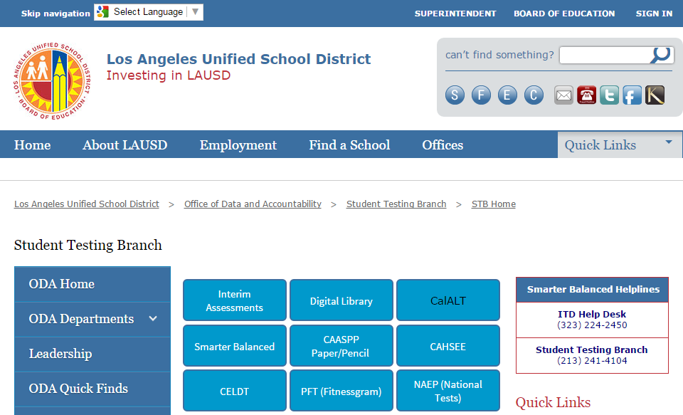
Digital Library Manage Accounts

Slide 3
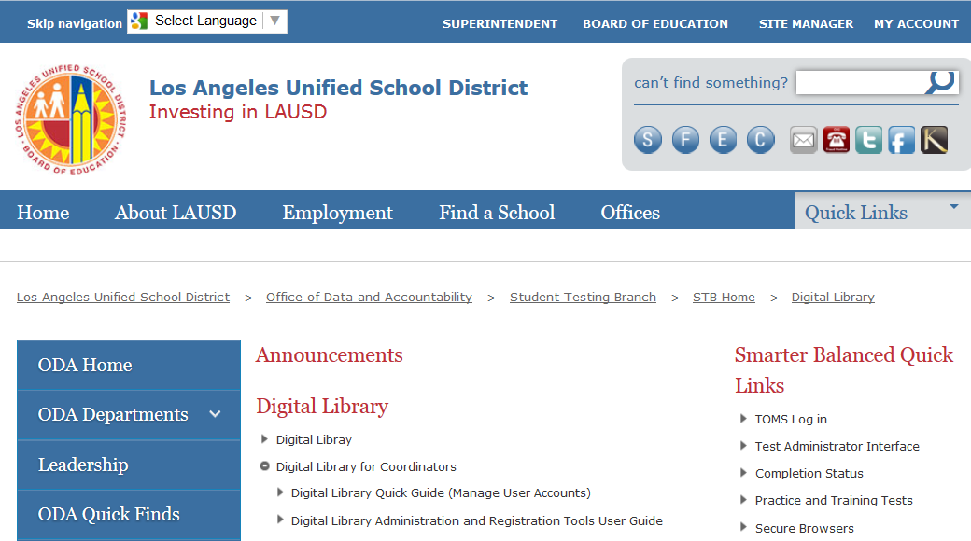
Digital Library Manage Accounts cont.

Slide 4
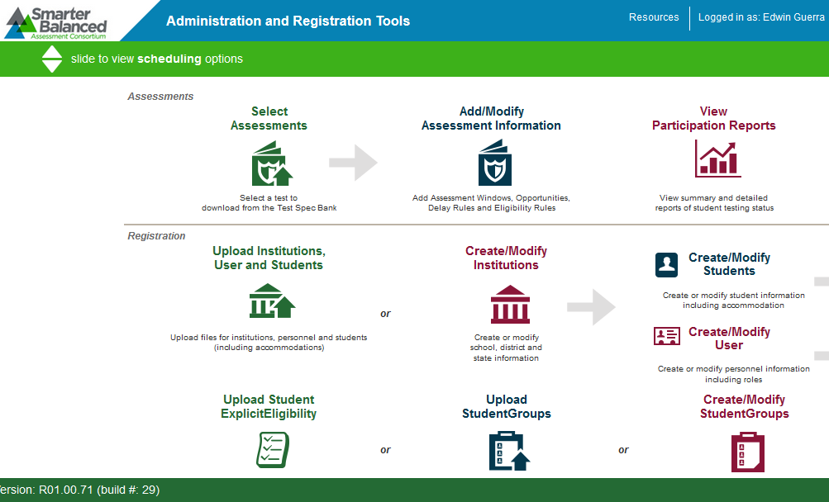
Digital Library Manage Accounts cont.

Slide 5
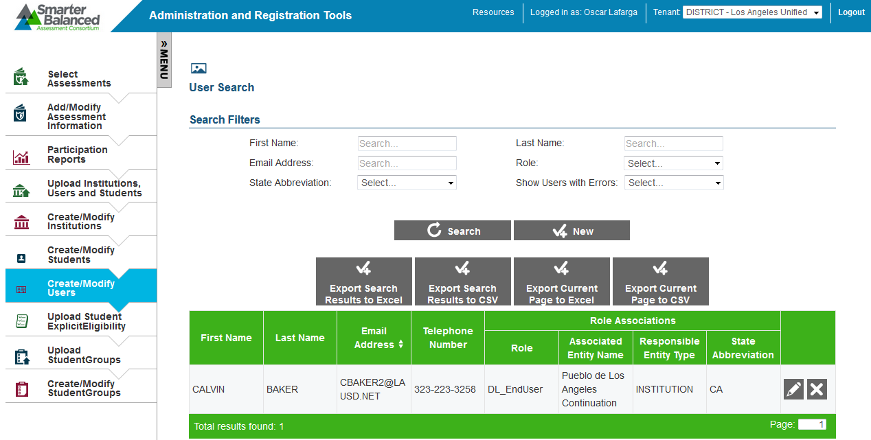
Digital Library Manage Accounts cont.
The accounts for all of the teachers associated with your school will appear. To manage an existing account, click on the icon of the pencil.
1

Slide 6
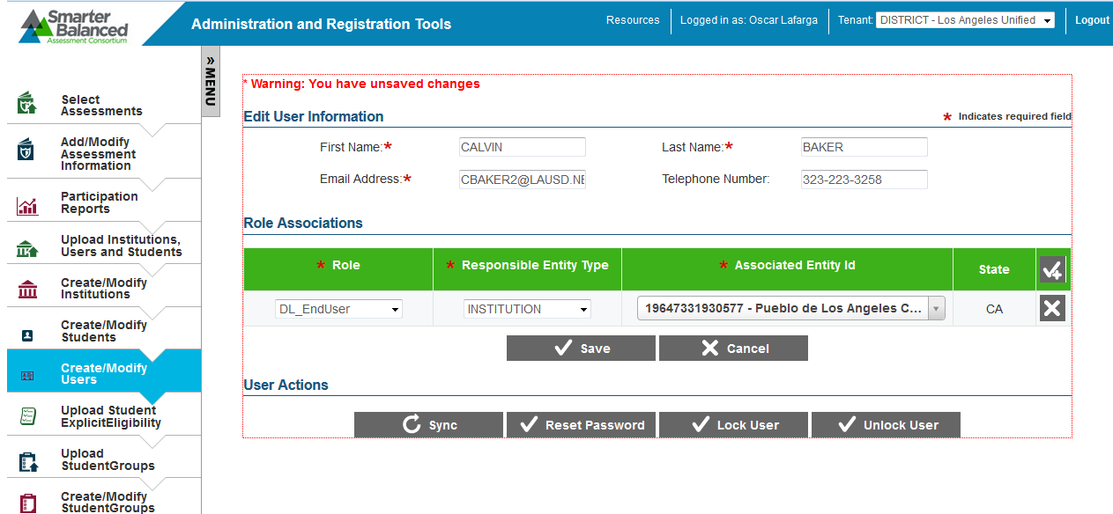
Digital Library Manage Accounts cont.
You will need to add 2 new ROLES to the account
The only existing ROLE will be that of DL_EndUser
To add the 2 new ROLES, click 2 times on the check mark with a + sign to open 2 new blank ROLES
B
A

Slide 7
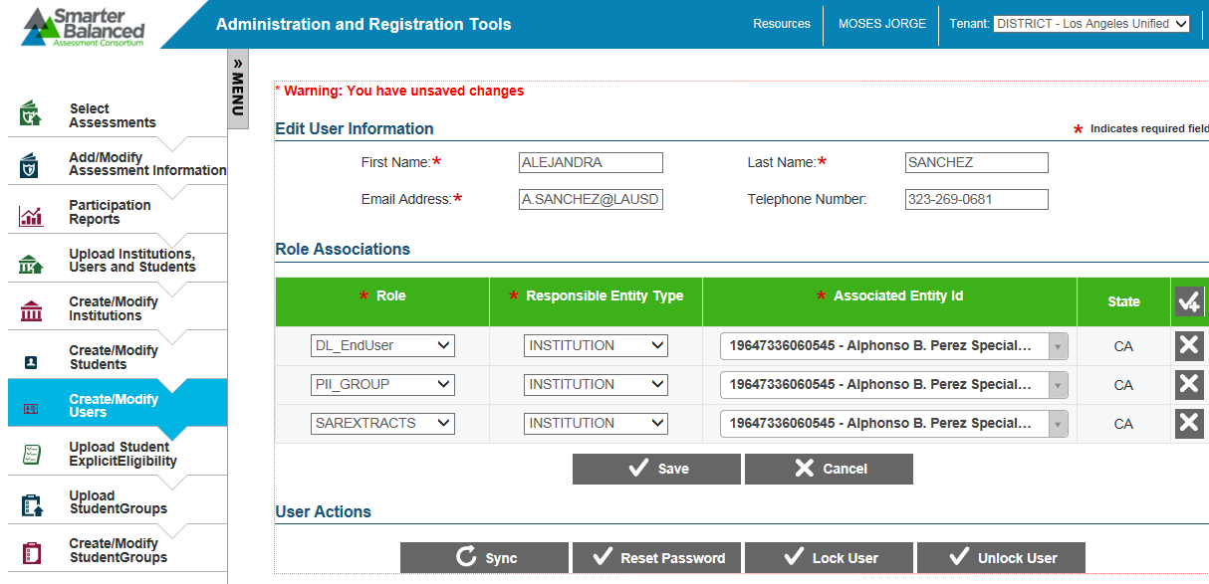
Digital Library Manage Accounts cont.
Add the 2 new ROLES of
PII_GROUP INSTITUTION School CDS Code
SAREXTRACTS INSTITUTION School CDS Code
Reset Password (If necessary)
Save
3
1A
1B
2

